Slide 1
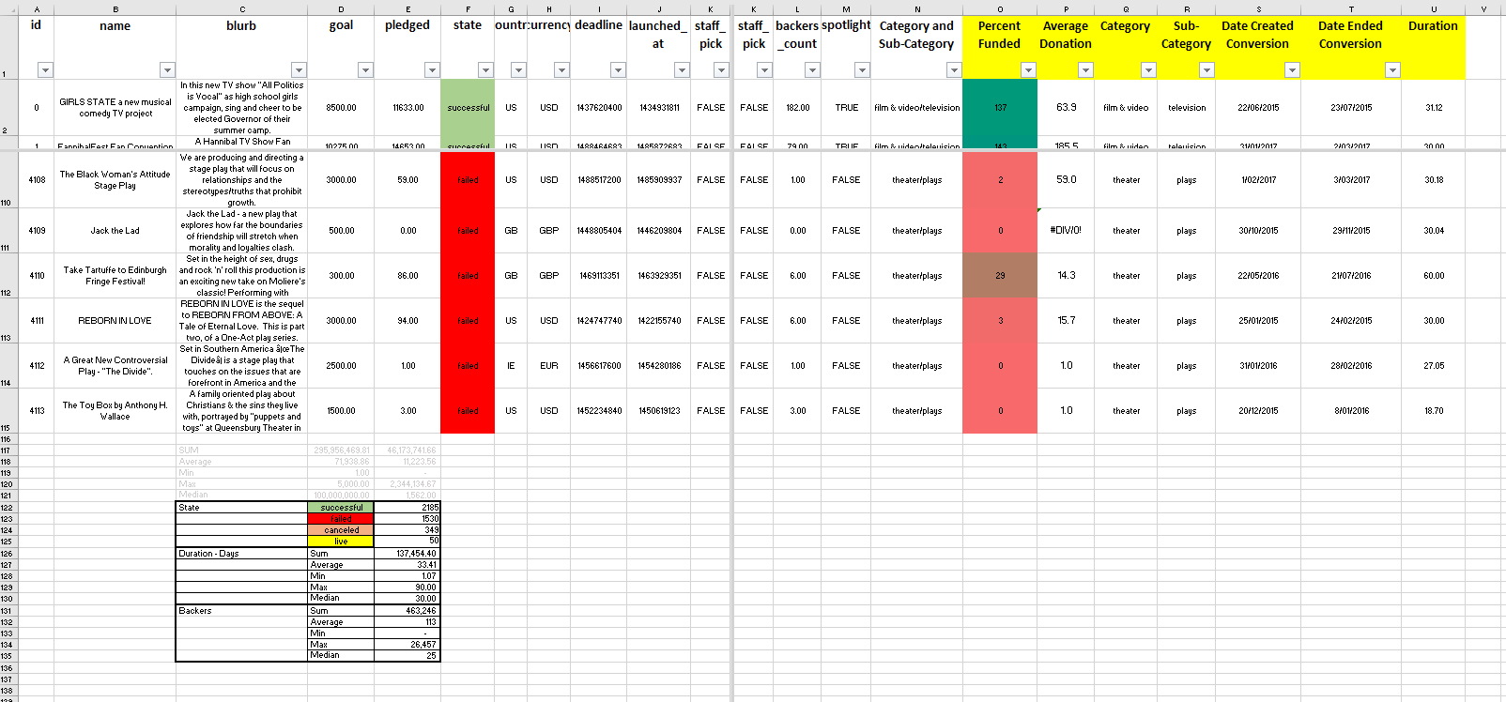
Excel Homework Sept 2021 (Steve Moss)
In Excel file: ‘ANS WORKSHEET’
Formatted State
New columns
Some basic stats

Slide 2
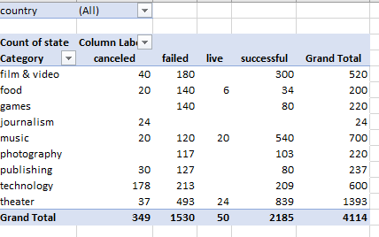
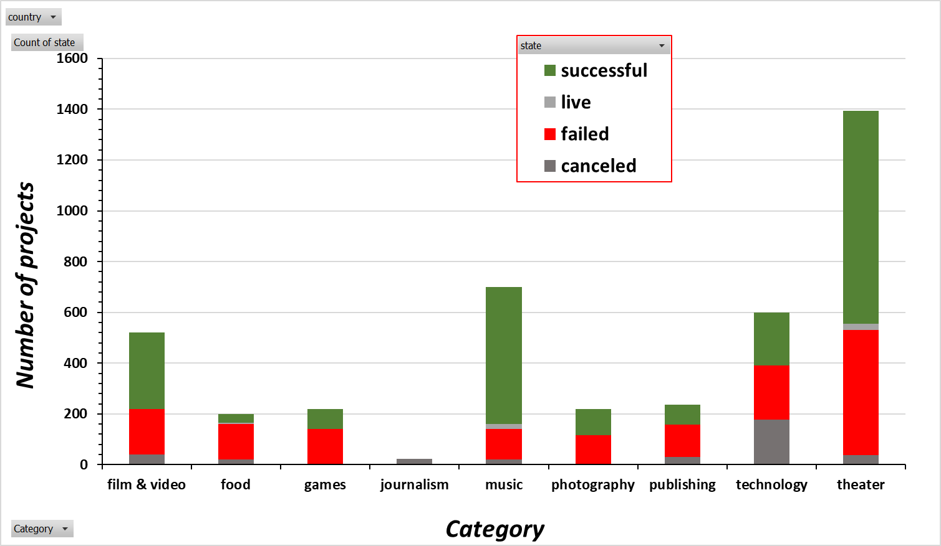
Excel Homework Sept 2021 (Steve Moss)
Pivot table and chart to show Success, failure, cancellation by category
In descending order the three least successful projects are publishing, food and journalism

Slide 3
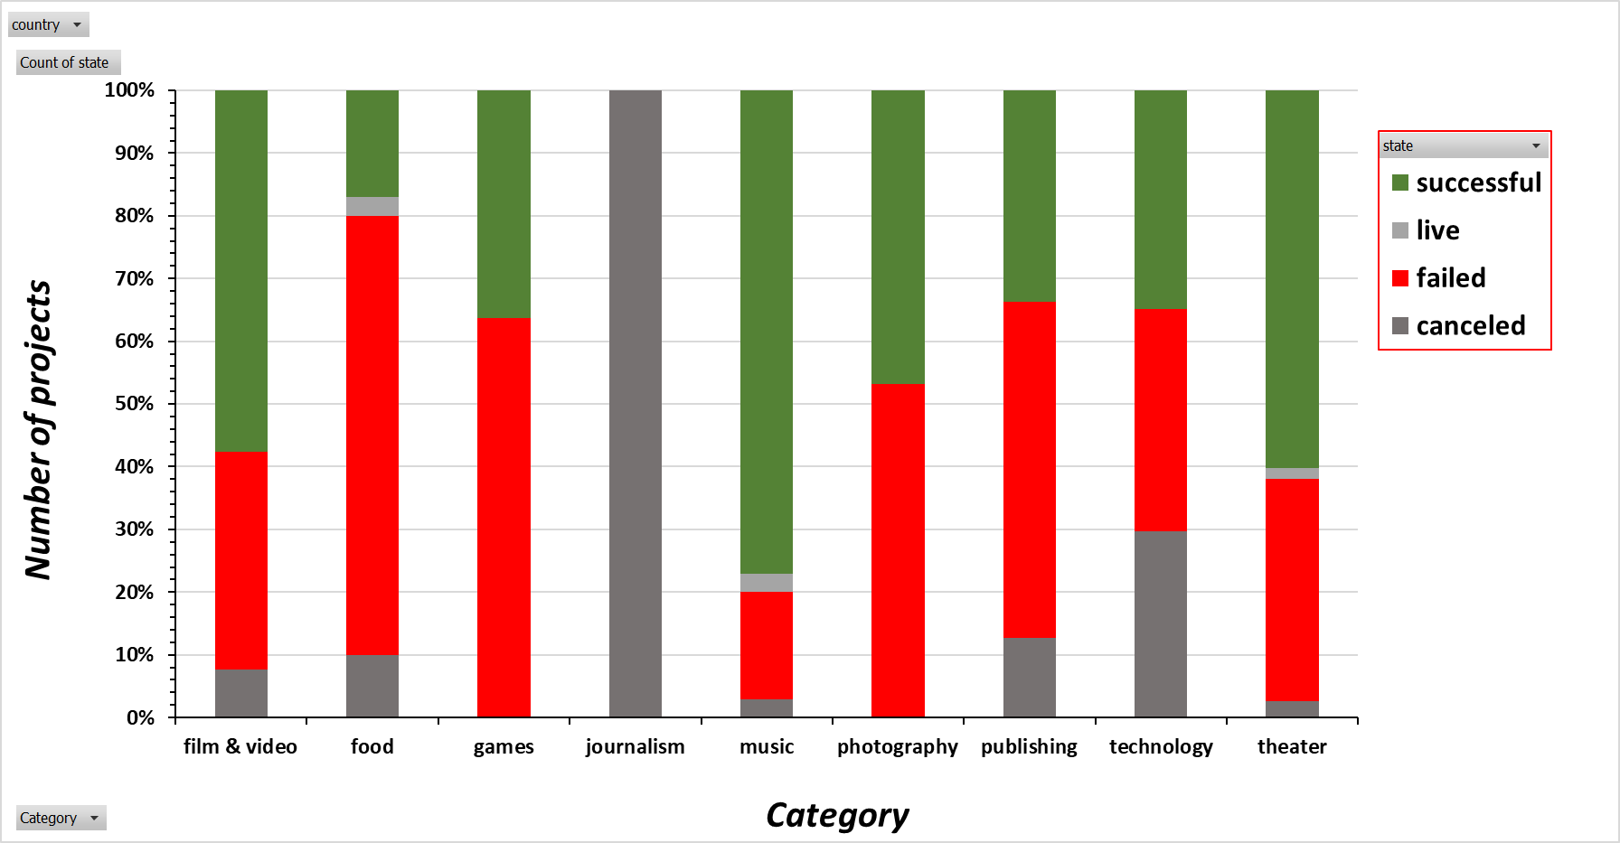
Excel Homework Sept 2021 (Steve Moss)
Pivot table and chart to show Success, failure, cancellation by category
Just using a different chart for the same data

Slide 4
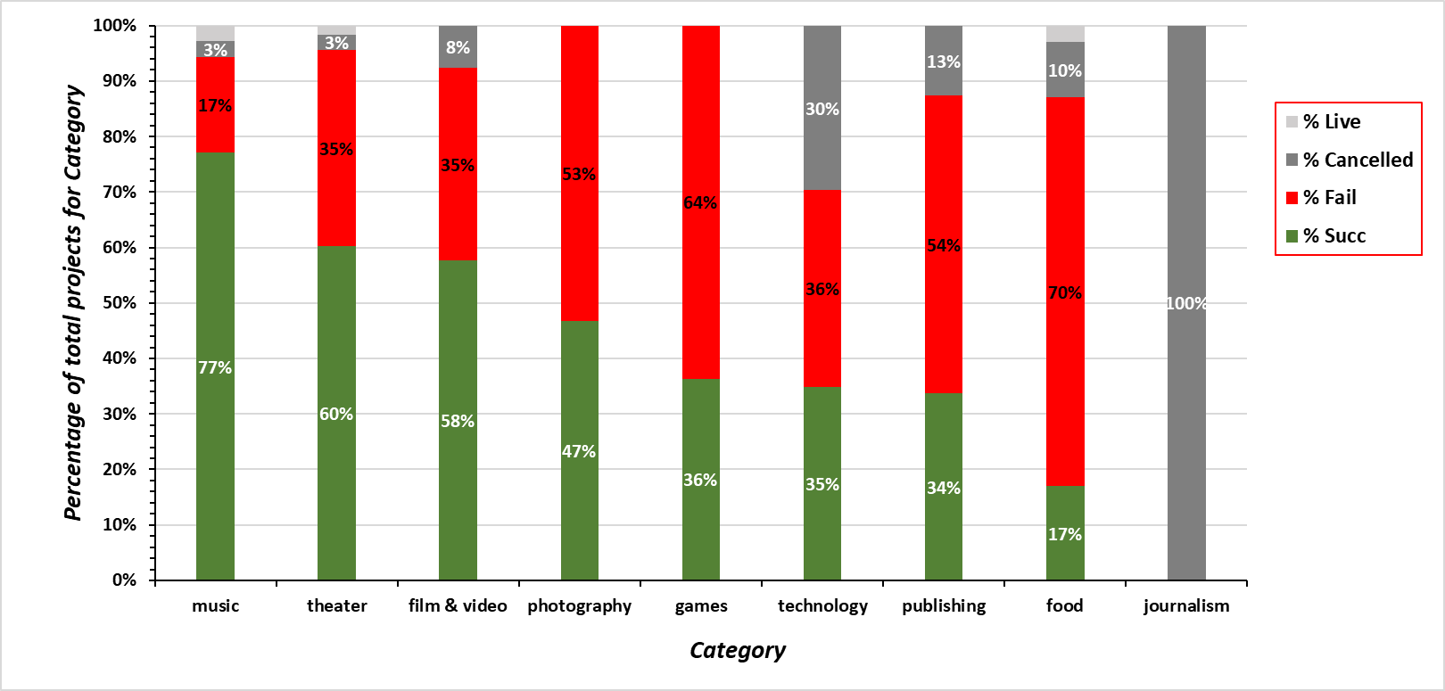
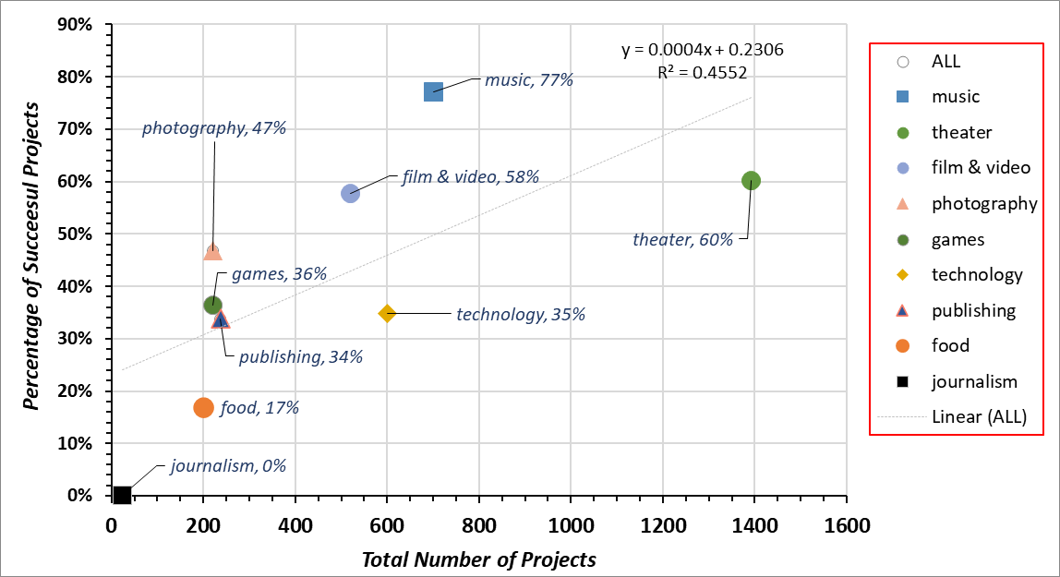
Excel Homework Sept 2021 (Steve Moss)
Copied Pivot table of show Success, failure, cancellation by category to new table
Calculated percentage of success, fail, cancel of total for each category in a different table and re-plotted
Plotting of data from pivot as percentage success, failure and cancel per category
Better representation of the data –
In descending order the three least successful projects are publishing, food and journalism
Scatter plot of data from pivot, percentage of successful projects per category vs total number of projects. Weak positive correlation

Slide 5
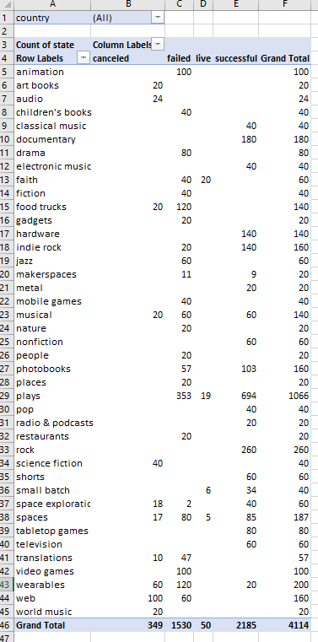
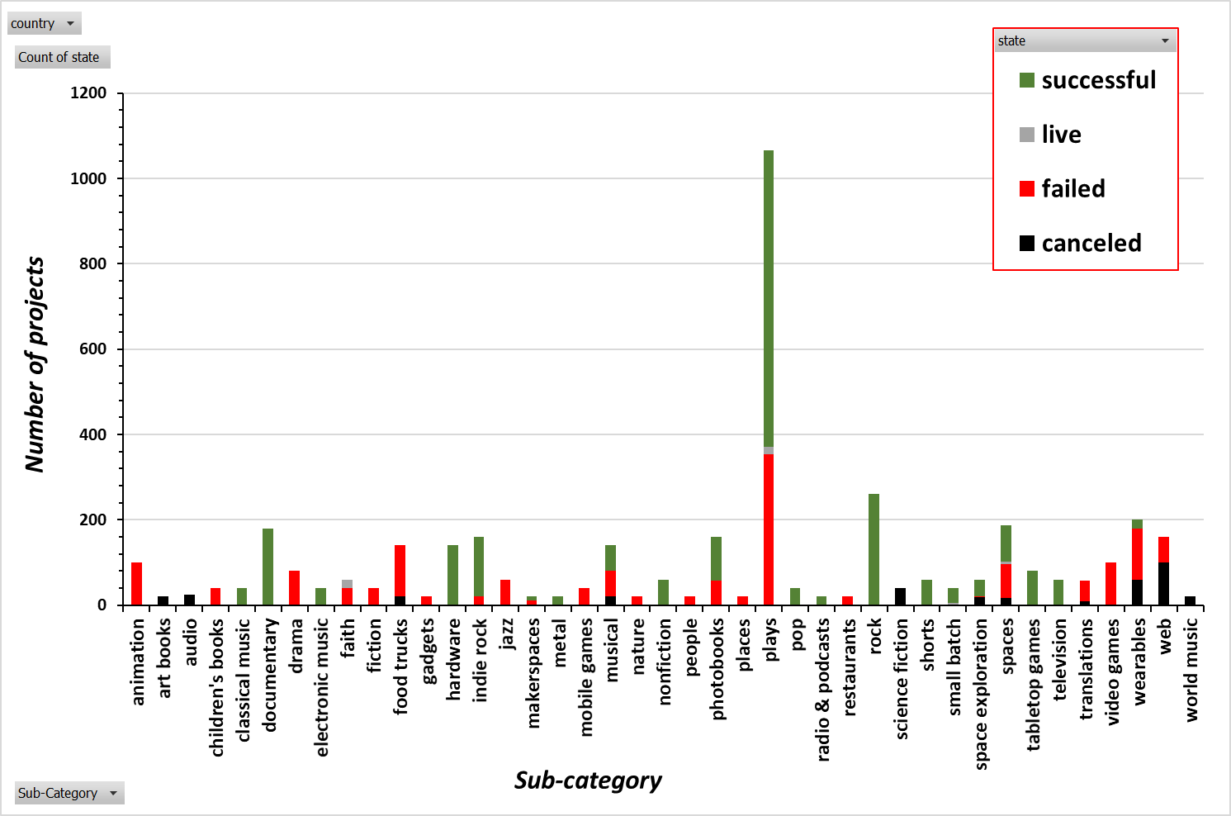
Excel Homework Sept 2021 (Steve Moss)
Pivot table and chart to show Success, failure, cancellation by Sub- category

Slide 6
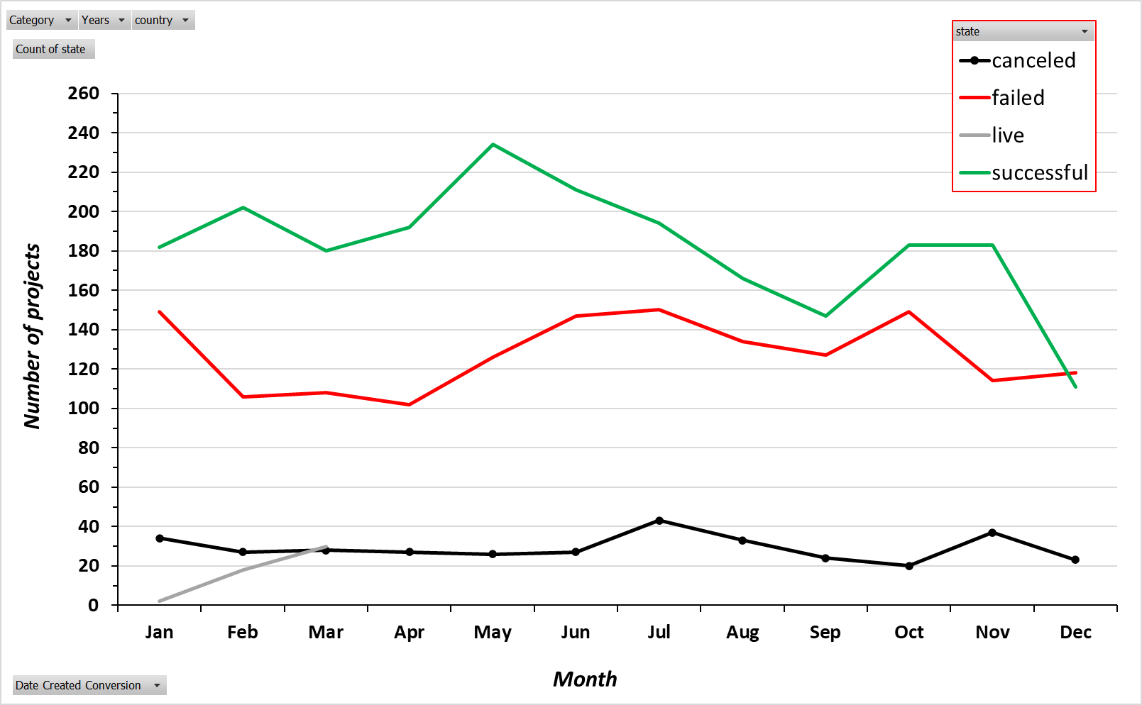
Excel Homework Sept 2021 (Steve Moss)
Pivot table and chart to show Success, failure, cancellation by date created
Overall May is best month to start project, December is worst

Slide 7
Excel Homework Sept 2021 (Steve Moss)
1. Given the provided data, what are three conclusions we can draw about Kickstarter campaigns?
Ans: (1) Over all countries the three most successful projects are 1st music, 2nd theatre and 3rd film & video. (2) In descending order the three least successful projects are publishing, food and journalism. (3) Over all countries, all categories and all years May is the best month to start a project with December being the worst
2. What are some limitations of this dataset?
Ans: the data on the monetary values of the project goal and the amount pledged are in 21 different currencies. If the data were converted to a single currency it would enable common stats (mean, median, min, max) to be calculated for the monetary value for each category and enable more meaningful comparisons. The data set is dominated by projects in the US and GB, co conclusions may be biased by cultural/consumer trends in those countries and not necessarily applicable to other countries.
What are some other possible tables and/or graphs that we could create
Ans: if the data were converted to a single currency we could compare success rate against the average value generated and see if the most successful always generate the most value. Could also plot value generated against project start to see if projects generate more value if initiated at certain times of the year.
Using the Pivot tables generated could use ‘filters’ to drill down further for category, country, date creation specific trends.

Slide 8
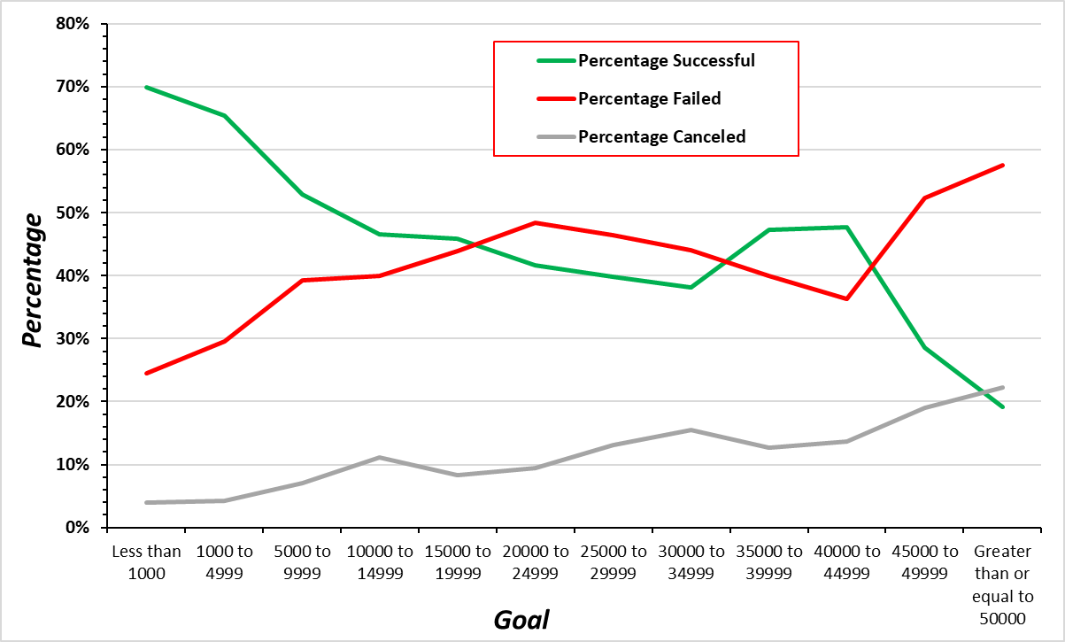
Excel Homework Sept 2021 (Steve Moss)
Bonus
The smaller the goal the greater the chance of a successful project
Likelihood of failure or cancellation increase with increasing goal size

Slide 9
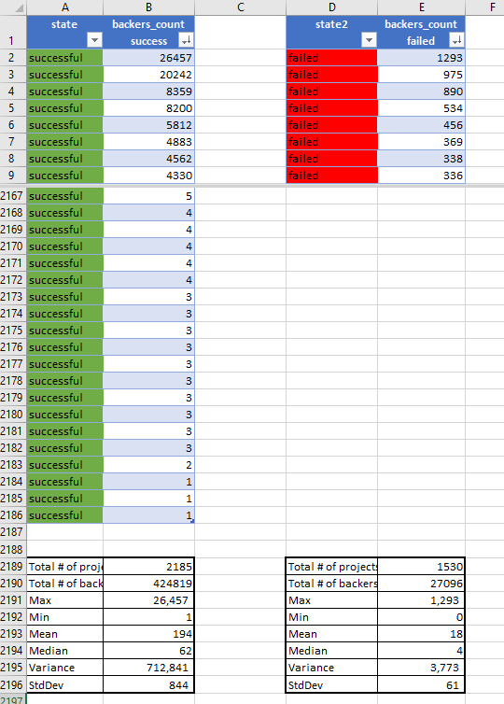
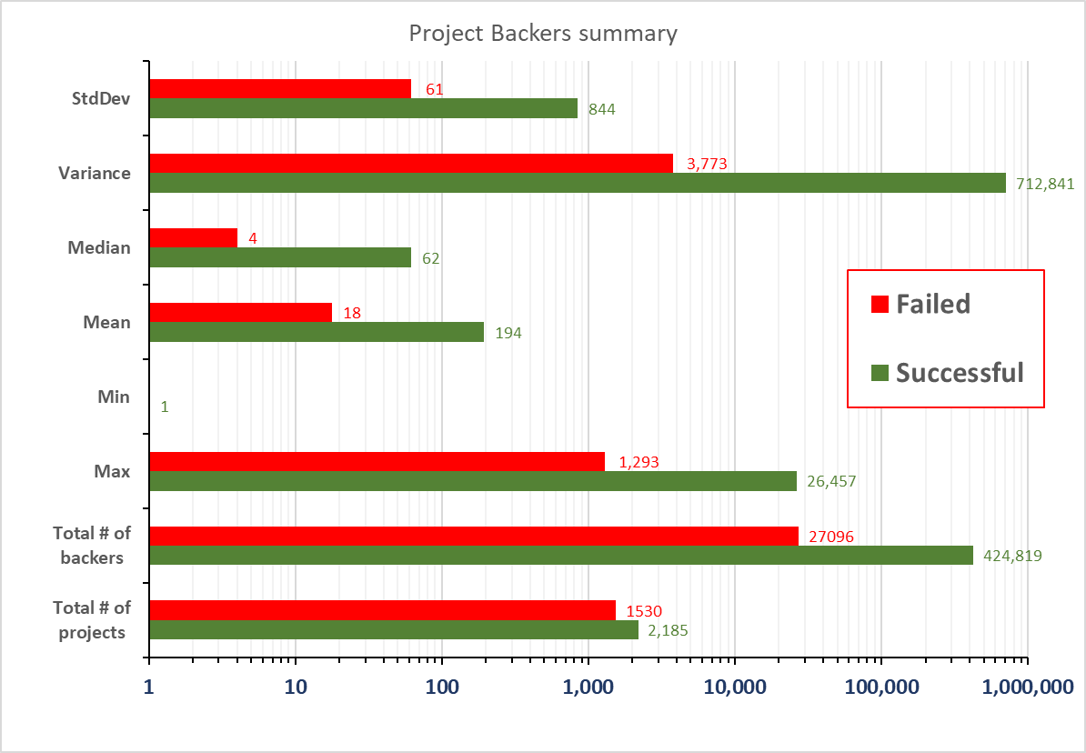
Excel Homework Sept 2021 (Steve Moss)
Bonus Statistical Analysis
Greater variability in the number of backers for successful campaigns
Suggests projects can be successful even with low number of backers (e.g. minimum of 1 backer)

